Slide 1
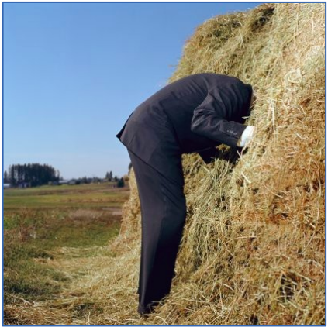
Variant annotation
Introduction to variant annotation
Odds Ratio and Relative Risks
Finding the mutations causative of diseases
Annotation tools (ANNOVAR, wANNOVAR, Variant Effect Predictor)
Understanding the annotation and the ClinVar database
Population structure
Loss-of-function variants
Variant annotation – January 2017 – Eran Elhaik

Slide 2





Slide 3

Notes:
Video

Slide 4
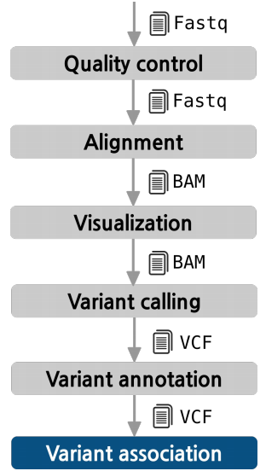
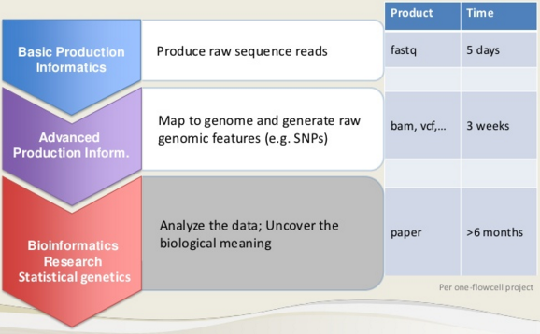
The pipeline so far
532 variants are significantly associated with the disease with high odds ratio (OR).
Now what ?

Slide 5
Odds Ratios and Relative Risk

Slide 6
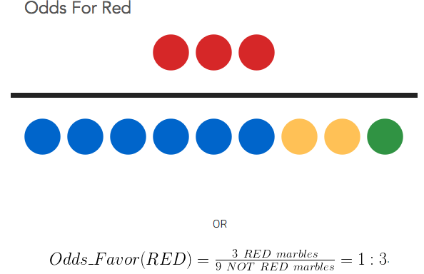
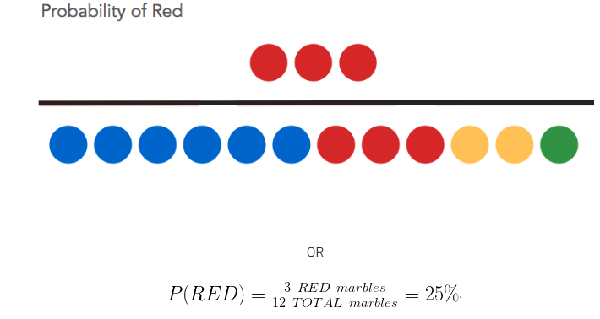
Odds and probabilities
Odds can have any value from zero to infinity and they represent a ratio of desired outcomes versus the field.
Probability is defined as the fraction of desired outcomes in the context of every possible outcome with a value between 0 and 1.
Notes:
http://stats.seandolinar.com/statistics-probability-vs-odds/

Slide 7
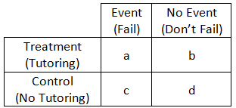
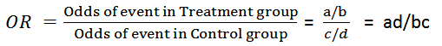
Odds Ratios
An odds ratio (OR) is a measure of association between an exposure and an outcome. OR represents the odds that an outcome will occur given a particular exposure, compared to the odds of the outcome occurring in the absence of that exposure.
ORs are used to compare the relative odds of the occurrence of the outcome of interest (e.g., disease or disorder), given exposure to the variable of interest (e.g., health characteristic, aspect of medical history).
The odds ratio can also be used to determine whether a particular exposure is a risk factor for a particular outcome, and to compare the magnitude of various risk factors for that outcome.
OR=1 Exposure does not affect odds of outcome
OR>1 Exposure associated with higher odds of outcome
OR<1 Exposure associated with lower odds of outcome
https://www.ncbi.nlm.nih.gov/pmc/articles/PMC2938757/
Notes:
Explaining Odds Ratios - https://www.ncbi.nlm.nih.gov/pmc/articles/PMC2938757/

Slide 8
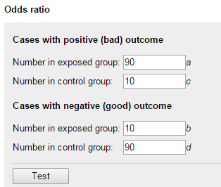
Let’s calculate some ORs
Online calculator: https://www.medcalc.org/calc/odds_ratio.php
You hold a case-control study.
You recruited 100 patients and 100 matching controls.
If 90 of your cases and 10 of your controls have
the alternative allele, what are the odds ratio?
Now assume that only 11 cases and 10 controls
show the alternative allele, what are the odds ratio?
Guidelines: oftentimes you will encounter statistically significant findings with OR that range between 1 and 1.5. OR <2 can be easily explained due to population structure. Be skeptical of OR smaller than 2.5-3.
McClellan J, King MC. 2010. Genetic heterogeneity in human disease. Cell. 141:210-217.

Slide 9
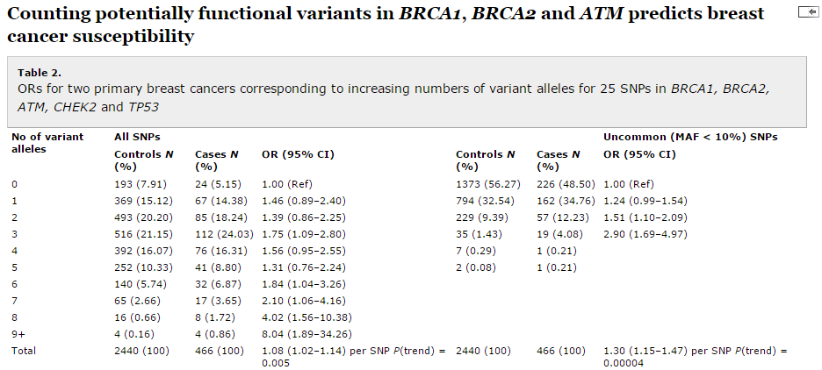
A disease allele?
To calculate overall risk for breast cancer, Johnson et al. (2007) counted the total alleles that had relative frequencies (in their control population) of less than 10%.
https://www.ncbi.nlm.nih.gov/pubmed/17341484?dopt=Abstract

Slide 10
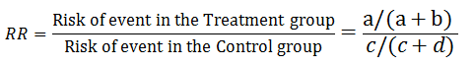
Relative Risk
RR is another way of measuring the effect of treatment.
OR and RR are oftentimes used interchangeably, but they mean different things.
OR is a ratio of two odds (obvious, right?)
RR is a ratio of two probabilities.
RR=1, the treatment made no difference. RR>1 the treatment has higher risk of failing compared to controls. RR<1 the treatment has lower risk of failing compared to controls.
The probability of an event in the Treatment group is a/(a+b)= R1
The probability of an event in the Control group is c/(c+d) = R2
RR = R1/R2
Ratio of event to
non-events
a measure of events out of all possible events
Notes:
http://sphweb.bumc.bu.edu/otlt/MPH-Modules/EP/EP713_Association/EP713_Association3.html

Slide 11
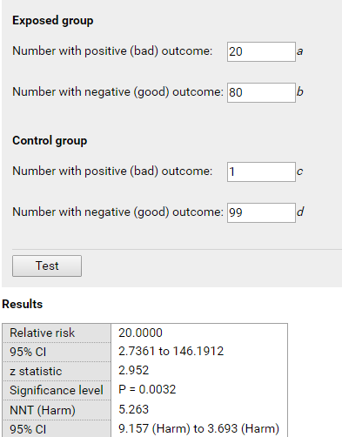
Let’s calculate some RRs
Calculator: https://www.medcalc.org/calc/relative_risk.php
What is the probability of developing cancer among people with a mutation in BRAC2?
20% of cancer patients were carriers of the mutation.
1% of cancer patients were not carriers of the mutation.
Here, a = 20, b = 80, c = 1, and d = 99.
What is the relative risk of cancer associated with this mutation?
BRCA2+
BRCA2-

Slide 12
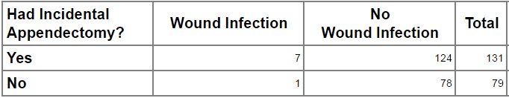
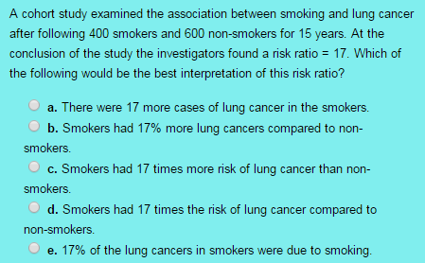
Exercise I
Answer the following questions:
Which of the following depends on the samples size: OR ,RR, or the p-value (explore with sample sizes of 10¹, 10², 10³)?
The table below shows how the risk ratio was calculated in the study examining the risk of wound infections when an incidental appendectomy was done during a staging laparotomy for Hodgkin disease. Calculate the RR and interpret the results.
.

Slide 13
Still confused between OR and RR?
Read the following example:
http://www.theanalysisfactor.com/the-difference-between-relative-risk-and-odds-ratios/
Remember:
RR is the probability of an event occurring (a/a+b)/the probability of the event not occurring (c/c+d).
OR is the odds of an even occurring (a/b)/the odds of the event not occurring (c/d).

Slide 14
What genomic mutations can cause a disease?

Slide 15
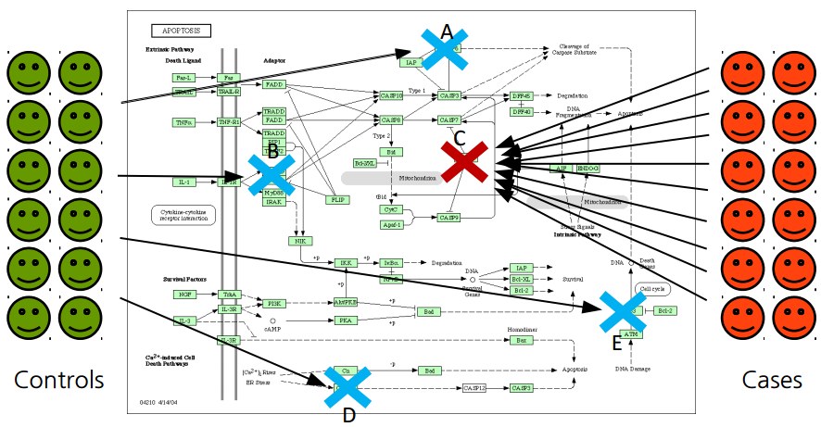
Finding the mutations causative of diseases
The simplest case: monogenic disease due to a single gene

Slide 16
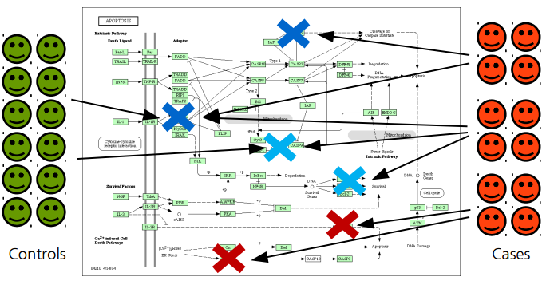
Clear individual gene associations are difficult to find in some diseases.
The same phenotype can be due to different mutations and different genes (or combinations). Many cases have to be used to obtain significant associations to many markers. The only common element is the pathway (yet unknown) affected.

Slide 17
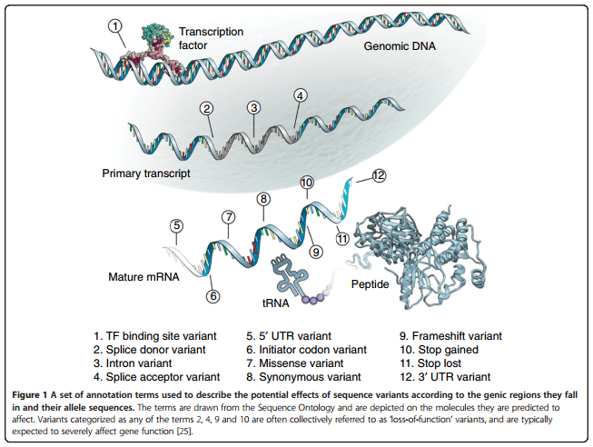
The challenge
Disease related mutations can be anywhere within and around the gene.
Each individual exome carries between 25,000 and 50,000 variants
Whole genome has up to 50 million variants on average
After annotating there will be hundreds of deleterious variants
Ritchie and Flicek. Genome Medicine. 2014. 6:87
Notes:
Mechanisms through which noncoding variants influence human disease
http://compbio.mit.edu/publications/81_Ward_NatureBiotechnology_12.pdf

Slide 18
Annotation tools
provide useful data about the mutation

Slide 19


Annotating the Variant
You did the perfect genetic study:
You chose a highly heritable disorder.
You collected many cases and controls.
You studied the complete genome.
You accounted for biases in the sequencing process and population structure.
You did a replication study and removed variants that were not replicated.
You still have several hundreds candidate variants!
How will you decide which of those is causal?
Notes:
http://www.messagetoeagle.com/are-some-of-our-dreams-glimpses-from-a-parallel-universe/

Slide 20
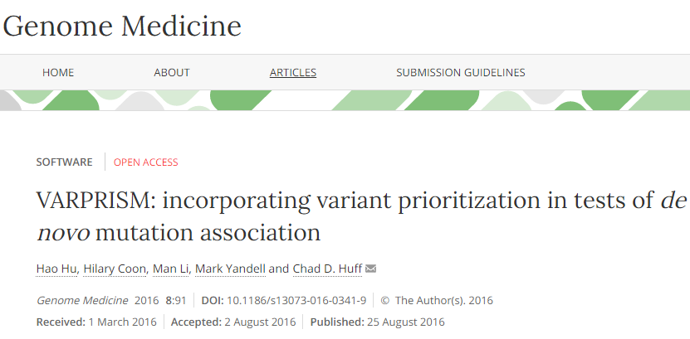
Annotating de novo mutations
VARiant PRIoritization SuM (VARPRISM) predicts the functional impact of de novo mutations and incorporates these quantitative predictions using a likelihood ratio test to evaluate evidence of de novo mutation load.
VARPRISM incorporates variant prioritization information to identify genes with a statistically significant excess of de novo mutations contributing to genetic diseases.

Slide 21
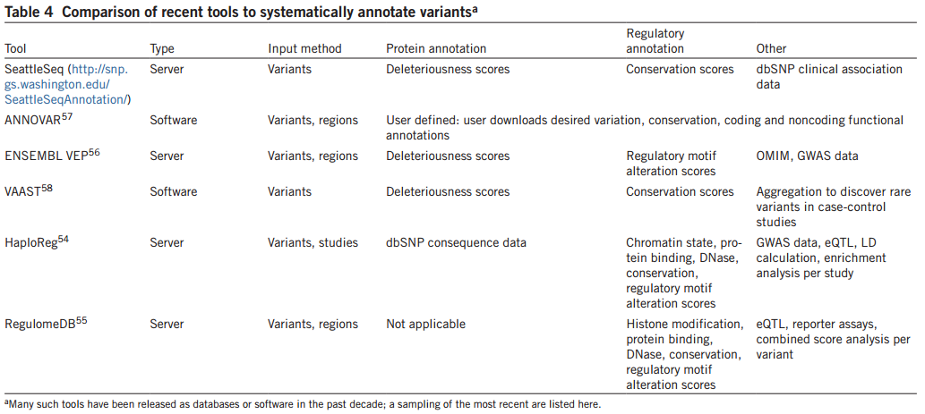
Using ANNOVAR for annotation
(http://annovar.openbioinformatics.org/en/latest/)
ANNOVAR is not a prediction tool – it is a shell.
ANNOVAR will not decide for you. It will generates a series of predictors made by other tools and combine it together in a user-friendly manner.
ANNOVAR obtains some of its data from DBNSFP (https://sites.google.com/site/jpopgen/dbNSFP), which uses > 400 categories to classify variants collected from different sources (see Variant annotation - dbNSFP3.1a.readme.txt in your Google Drive).
ANNOVAR is implemented in GALAXY.
What are the problems with this type of information?
L. D. Ward, M. Kellis, Nat. Biotechnol. 30, 1095-1106 (2012).
Notes:
Which tools get in? different predictors give different answers? Which predictors to use? Which categories to use? Only standard settings are used

Slide 22
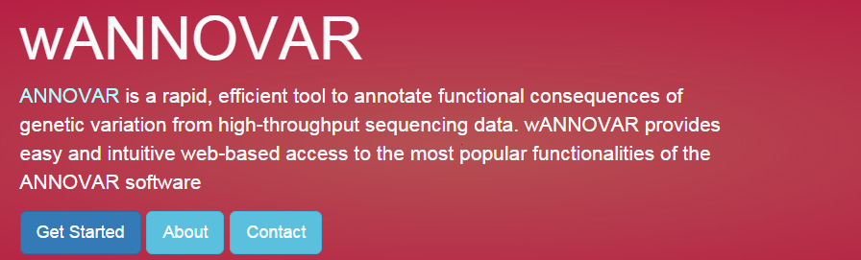
http://wannovar.wglab.org/
##fileformat=VCFv4.1
##contenttype=HumanOmni25M-8v1-1_B.bpm
##sourcereport=FinalReport_HumanOmni25M-8v1-1_PG0001217-BLD.txt
##genomemap=HumanOmni25M-8v1-1.NCBI37.map.txt
##contig=<ID=NA,length=0,Description="Contig undetermined-for genotyped alleles that do not map to the reference.">
##INFO=<ID=AL,Number=1,Type=String,Description="Array Alleles">
##INFO=<ID=ST,Number=1,Type=String,Description="ProbeStrand">
##FILTER=<ID=GTEX,Description="Genotype excluded from reference sequence mapping.">
##FILTER=<ID=NOCALL,Description="Genotype not called on array.">
##FORMAT=<ID=GC,Number=1,Type=Float,Description="GencallScore">
##FORMAT=<ID=GT,Number=1,Type=String,Description="Genotype">
##workflow_type=Illumina_GenotypingToVCF
##workflow_version=v1.4
#CHROM POS ID REF ALT QUAL FILTER INFO FORMAT WG0231131-DNAD01-PG0001217-BLD
chr7 117149177 rs75961395 A G . PASS AL=A/G;ST=- GT:GC 0/1:0.9120
Results

Slide 23
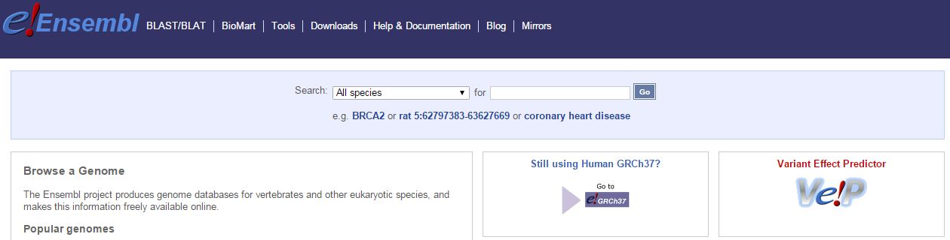
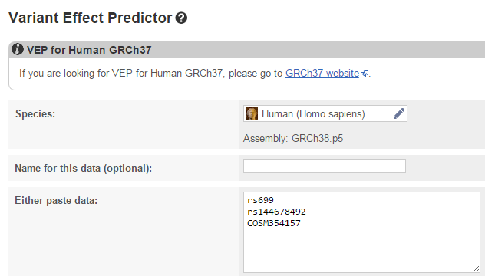
http://www.ensembl.org/index.html
Variant Effect Predictor (VEP)
Works similarly to wANNOVAR, but faster

Slide 24
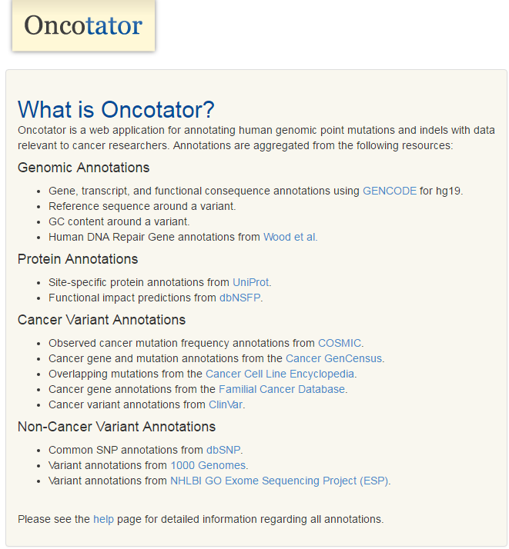
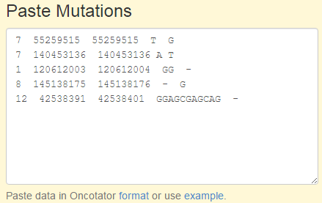
http://portals.broadinstitute.org/oncotator/

Slide 25
Exploring genetic variation (GEMINI)
https://gemini.readthedocs.org/en/latest/
GEMINI (GEnome MINIng) - a flexible framework for exploring genetic variation in the context of the wealth of genome annotations available for the human genome.
GEMINI provides a simple, flexible, and powerful system for exploring genetic variation for disease and population genetics.
Accepts VCF file. Each variant is automatically annotated by comparing it to several genome annotations from source such as ENCODE tracks, UCSC tracks, OMIM, dbSNP, KEGG, and HPRD. All of this information is stored in portable SQLite database that allows one to explore and interpret both coding and non-coding variation using “off-the-shelf” tools or an enhanced SQL engine.

Slide 26

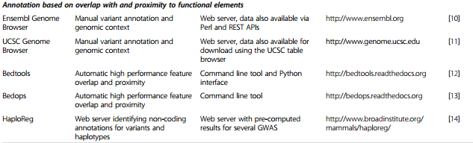
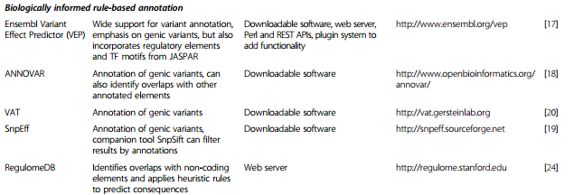
Your toolkit

Slide 27
How to decide?
Reproducibility
Reproducibility
Reproducibility
Reproducibility
Reproducibility
Reproducibility
Reproducibility
Reproducibility
Reproducibility
Reproducibility
Reproducibility
Reproducibility
Reproducibility
Reproducibility
Reproducibility
Reproducibility
Reproducibility
Reproducibility
Reproducibility
Reproducibility
Reproducibility
Reproducibility
Reproducibility
Reproducibility
Reproducibility
Reproducibility
Reproducibility
Reproducibility
Reproducibility
Reproducibility
Reproducibility
Reproducibility
Reproducibility
Reproducibility
Reproducibility
Reproducibility
Reproducibility
Reproducibility
Reproducibility
Reproducibility
Reproducibility
Reproducibility
Reproducibility
Reproducibility
Reproducibility
Reproducibility
Reproducibility
Reproducibility
Reproducibility
Reproducibility
Reproducibility
Reproducibility
Reproducibility
Reproducibility
Reproducibility
Reproducibility
Reproducibility
Reproducibility
Reproducibility
Reproducibility

Slide 28
Understanding the annotation

Slide 29
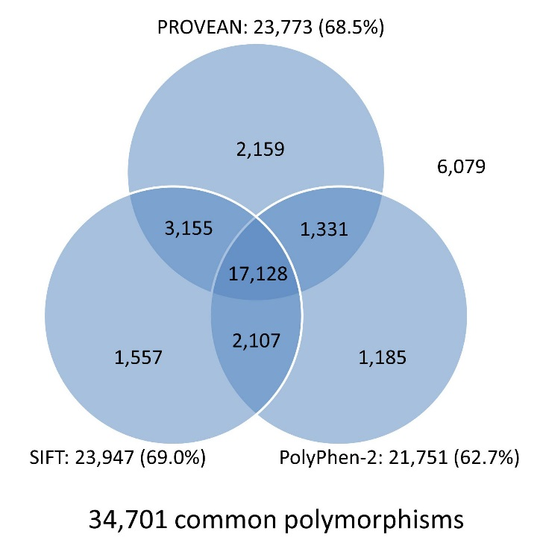
Understanding the annotation
Functional predictions
For variants found in protein-coding mutations, knowledge of protein structure and function, and the unambiguous nature of the genetic code, have allowed the development of a class of predictive algorithms that can score the severity of missense and nonsense variants (e.g., SIFT and PolyPhen).
These tools product a decision about variants in the form of:
Damaging/Possibly damaging/Benign
http://provean.jcvi.org/about.v1.0.php
Notes:
http://compbio.mit.edu/publications/81_Ward_NatureBiotechnology_12.pdf

Slide 30
Conservation scores
Even in the absence of conserved sequence, the conservation of biochemical activity can be indicative of conserved functional elements, even when the corresponding sequence features are not detectable by traditional alignment and constraint measures owing to turnover.
Because some fraction of protein binding and RNA transcription may be nonfunctional ‘noise,’ cross-species analysis of transcription factor binding or gene expression can help reveal the subset of elements that are most likely to be functional. However, lineage-specific elements may nevertheless be important and may not be captured through this method. Moreover, relying on conservation alone can fail to capture human specific constraint.
Finally, different parts of proteins can have different functions, suggesting that it will ultimately be more informative to focus attention on functionally distinct
portions of genes.
Common tools: Phylop, phastCons
Notes:
https://genomebiology.biomedcentral.com/articles/10.1186/s13059-016-0869-4

Slide 31
Other categories
Noncoding variants. Several resources, including HaploReg, RegulomeDB, and ENSEMBL’s Variant Effect Predictor annotate noncoding common variants from association studies using conservation, functional genomics and regulatory motif data.
Gene set enrichment analysis. Prior knowledge of gene interrelationships can be leveraged gene expression studies to discover differentially regulated pathways, even where single genes in those pathways change expression too little to rise to statistical significance. These methods for gene-set enrichment analysis (GSEA) are being applied to GWAS, where, similarly, genetic risk is expected to be concentrated along biological pathways and multiple testing diminishes the statistical significance of associations considered individually.
Regulatory element enrichment analysis. A recent study used chromatin state maps to discover an enrichment of cell type–specific enhancers among the top associations in several GWAS, demonstrating the ability of high-resolution functional genomics maps to serve as a type of pathway annotation
Gene expression. Variation in gene expressions in different tissues may imply on the functionality of the gene (e.g., GTEx).

Slide 32
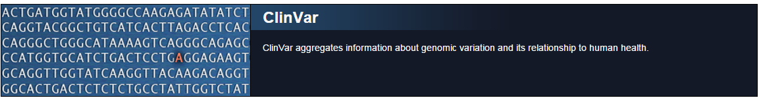
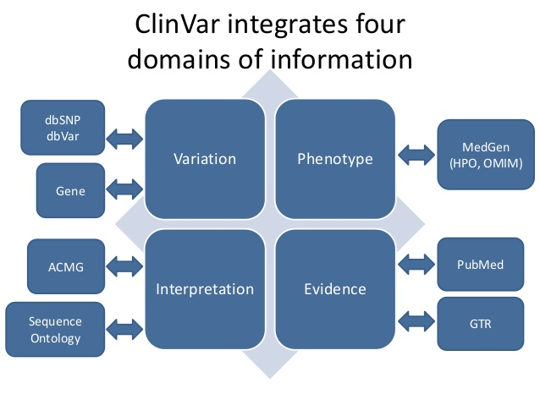
Popular among clinicians…

Slide 33
Exercise II
Use ClinVar to find how many pathogenic variants are in the NFKB1 gene? How reliable is this information?
The CHD8 gene is known to be associated with autism. Annotate the CHD8 SNP Rs192989929 using any annotation tool. What is your diagnostic?
Use any annotation tool to annotate the following variants. What is your diagnostic?
How will you decide which variants are causal?
Which genes harbor these variants? To which pathways they belong to?
rs121908745 rs78655421 rs77932196
rs2572886 rs9264942
rs2745557 rs1143674 rs1445442
rs2075575 rs4800773 rs2075575
rs13186740 rs2042959 rs4867387
rs104886271 rs80359806 rs80359796
rs4481887 rs2153271 rs1042725
Notes:
One star – one submitter
SNPs were taken from the following sources: Cystic Fibrosis/HIV/ASD/SIDS/Genochip (not functional)/Non disease SNPs/traits

Slide 34
I finished my analysis, now what?
Some web sites offer free, user-friendly analysis.
A partial list of websites that accept transcript IDs and/or gene IDs:
DAVID (http://david.abcc.ncifcrf.gov/tools.jsp)
ConsensusPathDB (http://cpdb.molgen.mpg.de/)
NetGestalt (http://www.netgestalt.org/)
Molecular Signatures Database (http://www.broadinstitute.org/gsea/msigdb/index.jsp)
PANTHER (http://www.pantherdb.org/)
Cognoscente (http://vanburenlab.medicine.tamhsc.edu/cognoscente.shtml)
Pathway Commons (http://www.pathwaycommons.org/)
Reactome (http://www.reactome.org/)
PathVisio (http://www.pathvisio.org/)
Moksiskaan (http://csbi.ltdk.helsinki.fi/moksiskaan/)
There are free solutions that require some programming knowledge, including several packages in Bioconductor (http://bioconductor.org/).
Commercial solutions include:
Ingenuity (http://www.ingenuity.com/products/ipa)
Advaita iPathwayGuide (https://apps.advaitabio.com/ipg/home)
Metacore (http://lsresearch.thomsonreuters.com/)

Slide 35
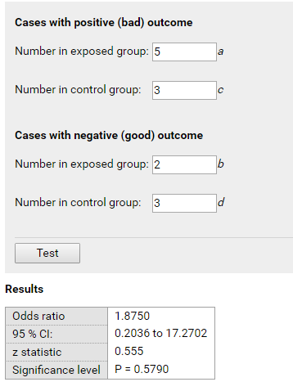
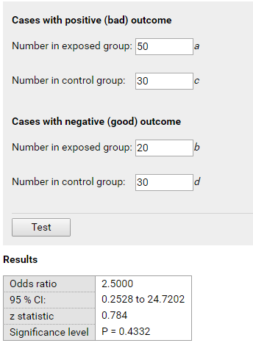
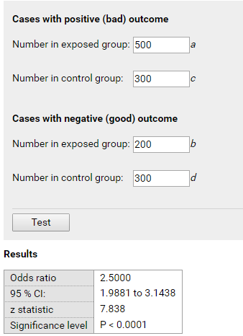
Answers to Exercise I
1) Using the calculators we can calculate OR and RR. The p-value is the only variable that depends on the sample size.
2) In this study patients who underwent incidental appendectomy had 4.2 times the risk of post-operative wound infection compared to patients who did not undergo incidental appendectomy.
3) d.

